Slide 1
DEPARTMENT OF ZOOLOGY

Slide 2
GLYCOLYSIS

Slide 3
Glycolysis is derived from the Greek words (glycose—sweet or sugar; lysis—dissolution).
It is a universal pathway in the living cells.
The complete pathway of glycolysis was elucidated in 1940.
This pathway is often referred to as Embden-Meyerhof pathway (E.M. pathway) in honour of the two biochemists who made a major contribution to the knowledge of glycolysis.
Glycolysis is defined as the sequence of reactions converting glucose (or glycogen) to pyruvate or lactate, with the production of ATP.

Slide 4
Salient features 1. Glycolysis takes place in all cells of the body. The enzymes of this pathway are present in the cytosomal fraction of the cell. 2. Glycolysis occurs in the absence of oxygen (anaerobic) or in the presence of oxygen (aerobic). Lactate is the end product under anaerobic condition. In the aerobic condition, pyruvate is formed, which is then oxidized to CO2 and H2O. 3. Glycolysis is a major pathway for ATP synthesis in tissues lacking mitochondria, e.G. Erythrocytes, cornea, lens etc. Glycolysis hexose monophosphate shunt other carbohydrates (galactose, fructose) glycogenesis lipogenesis (synthesis of fat) non-essential amino acids Oxidative pathways synthetic pathways

Slide 5
4. Glycolysis is very essential for brain which is dependent on glucose for energy. The glucose in brain has to undergo glycolysis before it is oxidized to CO2 and H2O.
5. Glycolysis (anaerobic) may be summarized by the net reaction
Glucose + 2ADP + 2Pi 2Lactate + 2ATP
6. Glycolysis is a central metabolic pathway with many of its intermediates providing branch point to other pathways. Thus, the intermediates of glycolysis are useful for the synthesis of amino acids and fat.
7. Reversal of glycolysis along with the alternate arrangements at the irreversible steps, will result in the synthesis of glucose (gluconeogenesis).

Slide 6
The pathway can be divided into three distinct phases
A. Energy investment phase or priming stage
B. Splitting phase
C. Energy generation phase.

Slide 7
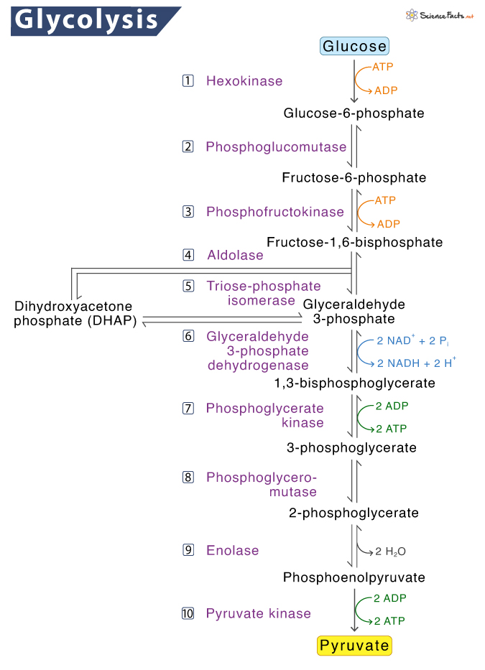

Slide 8
Energy investment phase
Glucose is phosphorylated to glucose 6-phosphate by hexokinase or glucokinase (both are isoenzymes).
This is an irreversible reaction, dependent on ATP and Mg2+. The enzyme hexokinase is present in almost all the tissues.
It catalyses the phosphorylation of various hexoses (fructose, mannose etc.), has low Km for substrates (about 0.1 mM) and is inhibited by glucose 6-phosphate.
Glucokinase present in liver, catalyses the phosphorylation of only glucose, has high Km for glucose (10 mM) and is not inhibited by glucose 6-phosphate. Due to high affinity (low Km), glucose is utilized by hexokinase even at low concentration,

Slide 9
whereas glucokinase acts only at higher levels of glucose i.e., after a meal when blood glucose concentration is above 100 mg/dl.
Glucose 6-phosphate is impermeable to the cell membrane.
It is a central molecule with a variety of metabolic fates—glycolysis, glycogenesis, gluconeogenesis and pentose phosphate pathway.
2. Glucose 6-phosphate undergoes isomerization to give fructose 6-phosphate in the presence of the enzyme phosphohexose isomerase and Mg2+.
3. Fructose 6-phosphate is phosphorylated to fructose 1,6-bisphosphate by phosphofructokinase (PFK). This is an irreversible and a regulatory step in glycolysis.

Slide 10
B. Splitting phase
4. The six carbon fructose 1,6- bisphosphate is split (hence the name glycolysis) to two three-carbon compounds, glyceraldehyde 3-phosphate and dihydroxyacetone phosphate by the enzyme aldolase (fructose 1,6- bisphosphate aldolase).
5. The enzyme phosphotriose isomerase catalyses the reversible interconversion of glyceraldehyde 3-phosphate and dihydroxyacetone phosphate. Thus, two molecules of glyceraldehyde 3-phosphate are obtained from one molecule of glucose.

Slide 11
C. Energy generation phase
6. Glyceraldehyde 3-phosphate dehydrogenase converts glyceraldehyde 3-phosphate to 1,3-bisphosphoglycerate. This step is important as it is involved in the formation of NADH + H+ and a high energy compound 1,3-bisphosphoglycerate.
Iodoacetate and arsenate inhibit the enzyme glyceraldehyde 3-phosphate dehydrogenase.
In aerobic condition, NADH passes through the electron transport chain and 6 ATP (2 u 3 ATP) are synthesized by oxidative phosphorylation.

Slide 12
7. The enzyme phosphoglycerate kinase acts on 1,3-bisphosphoglycerate resulting in the synthesis of ATP and formation of 3-phosphoglycerate.
This step is a good example of substrate level phosphorylation, since ATP is synthesized from the substrate without the involvement of electron transport chain.
Phosphoglycerate kinase reaction is reversible, a rare example among the kinase reactions.
8. 3-Phosphoglycerate is converted to 2-phosphoglycerate by phosphoglycerate mutase. This is an isomerization reaction.

Slide 13
The high energy compound phosphoenol pyruvate is generated from 2-phosphoglycerate by the enzyme enolase.
This enzyme requires Mg2+ or Mn2+ and is inhibited by fluoride.
For blood glucose estimation in the laboratory, fluoride is added to the blood to prevent glycolysis by the cells, so that blood glucose is correctly estimated.
(Fluoride combines with Mg2+ and phosphate to form a complex that binds with active site of enolase and blocks access of substrate. Thus, fluoride is an unusual competitive inhibitor).
10. The enzyme pyruvate kinase catalyses the transfer of high energy phosphate from phosphoenol pyruvate to ADP, leading to the formation of ATP. This step also is a substrate level phosphorylation. This reaction is irreversible.

Slide 14
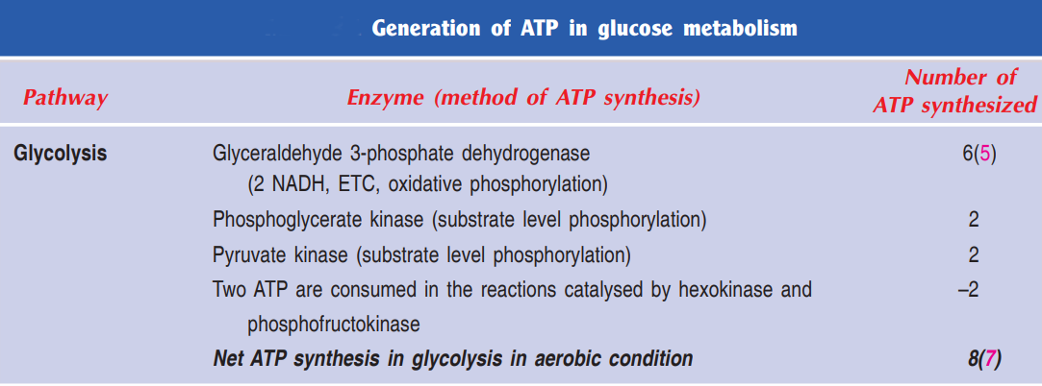

Slide 15
Thank You

